Slide 1


APLIKASI Di LINUX
Padanan dengan Windows

Slide 2




Perkenalkan
@mbah_noto
Arif Eko Pratono
arifep2000@gmail.com

Slide 3

Kebutuhan Aplikasi
Office atau Perkantoran
Multimedia
  Entertainment
  Graphic
  Sound Editing
  Video Editing
Programming
  Web Programming
  Desktop Programming
  Analysis Programming
Internet
  Browser
  Messenger
  Social Network
System Tools
Accessories

Slide 4

OFFICE

Slide 5

OFFICE
Microsoft Office
  Microsoft Word
  Microsoft Excel
  Microsoft Powerpoint
  Microsoft Access
  Microsoft Visio
  Microsoft Project
Libre Office
  Libre Writer
  Libre Calc
  Libre Impress
  Libre Base
Dia Diagram
OpenProj

Slide 6
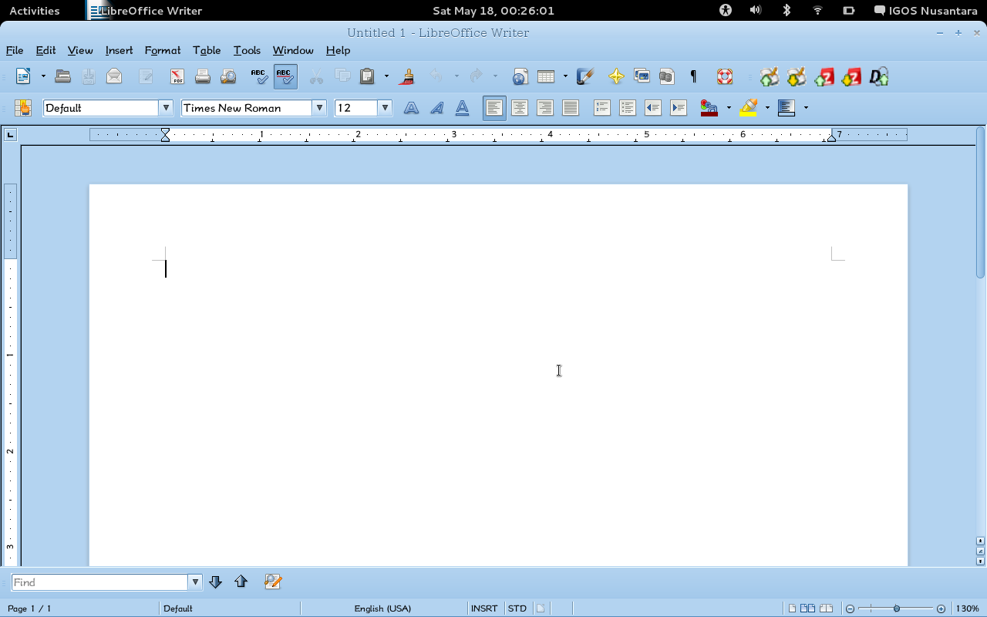
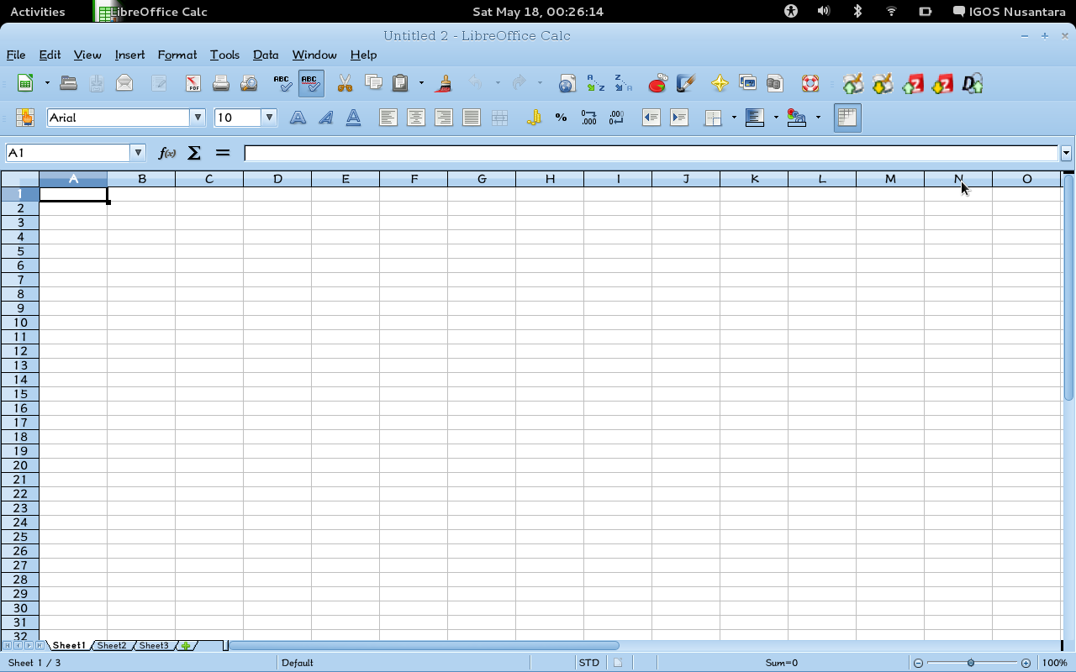
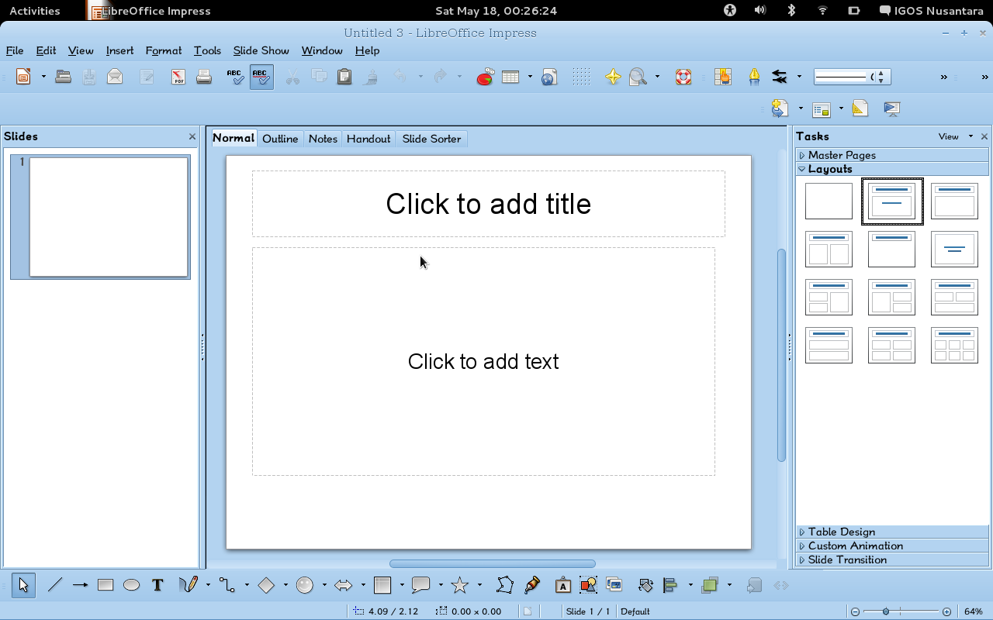
Tampilan Office
Di Linux

Slide 7

MULTIMEDIA
Entertainment
Graphic
Sound Editing
Video Editing

Slide 8

MULTIMEDIA
Entertainment
Winamp,JetAudio
Windows Media Player,VLC
Media Center
Nero Burning
Audacious,Amarok
VLC,TotemPlayer
XBMC
Brasero,K3B,Nero4Linux

Slide 9
MULTIMEDIA
Graphic
Corel Draw
Adobe illustrator
Adobe Photoshop
Paint
Auto CAD
ACDSee
Adobe PageMaker
Inkscape
SK1
Gimp
Pinta
DraftSight
F-Spot
Scribus

Slide 10

MULTIMEDIA
Sound Editing
Audacity
LMMS
Mixxx
Internet DJ Console
Cool Edit Pro
Adobe Audition
SAM Broadcaster
MB Studio
Fruity Loops

Slide 11
MULTIMEDIA
Video Editing
WMM
Adobe Premier
Desktop Session Recording
Adobe After Effect
Cinerella
KdenLive
Blender
LiVES
OpenShot
Pitivi
Istanbul

Slide 12
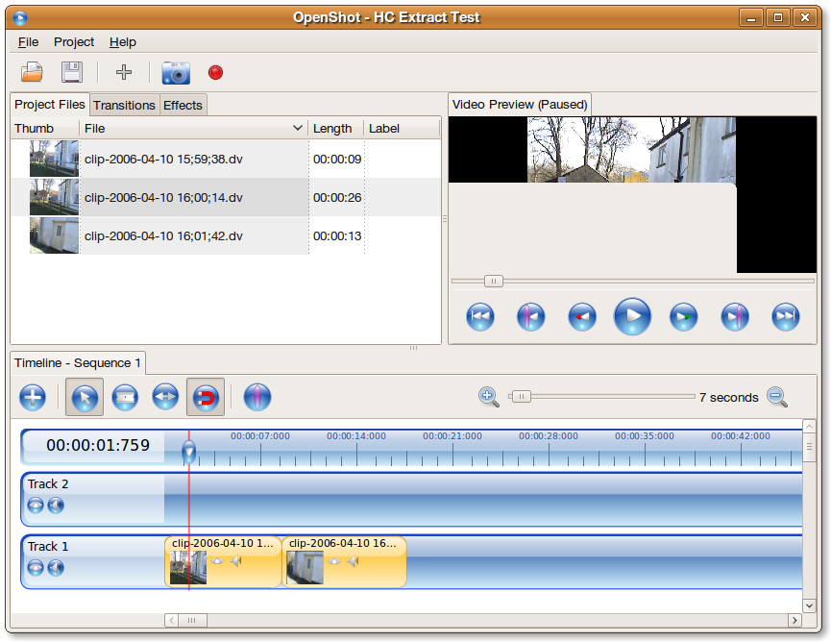
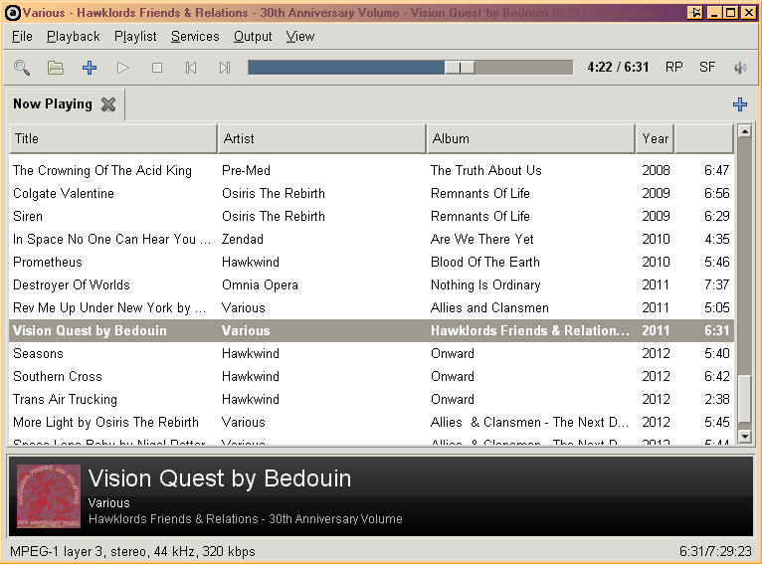
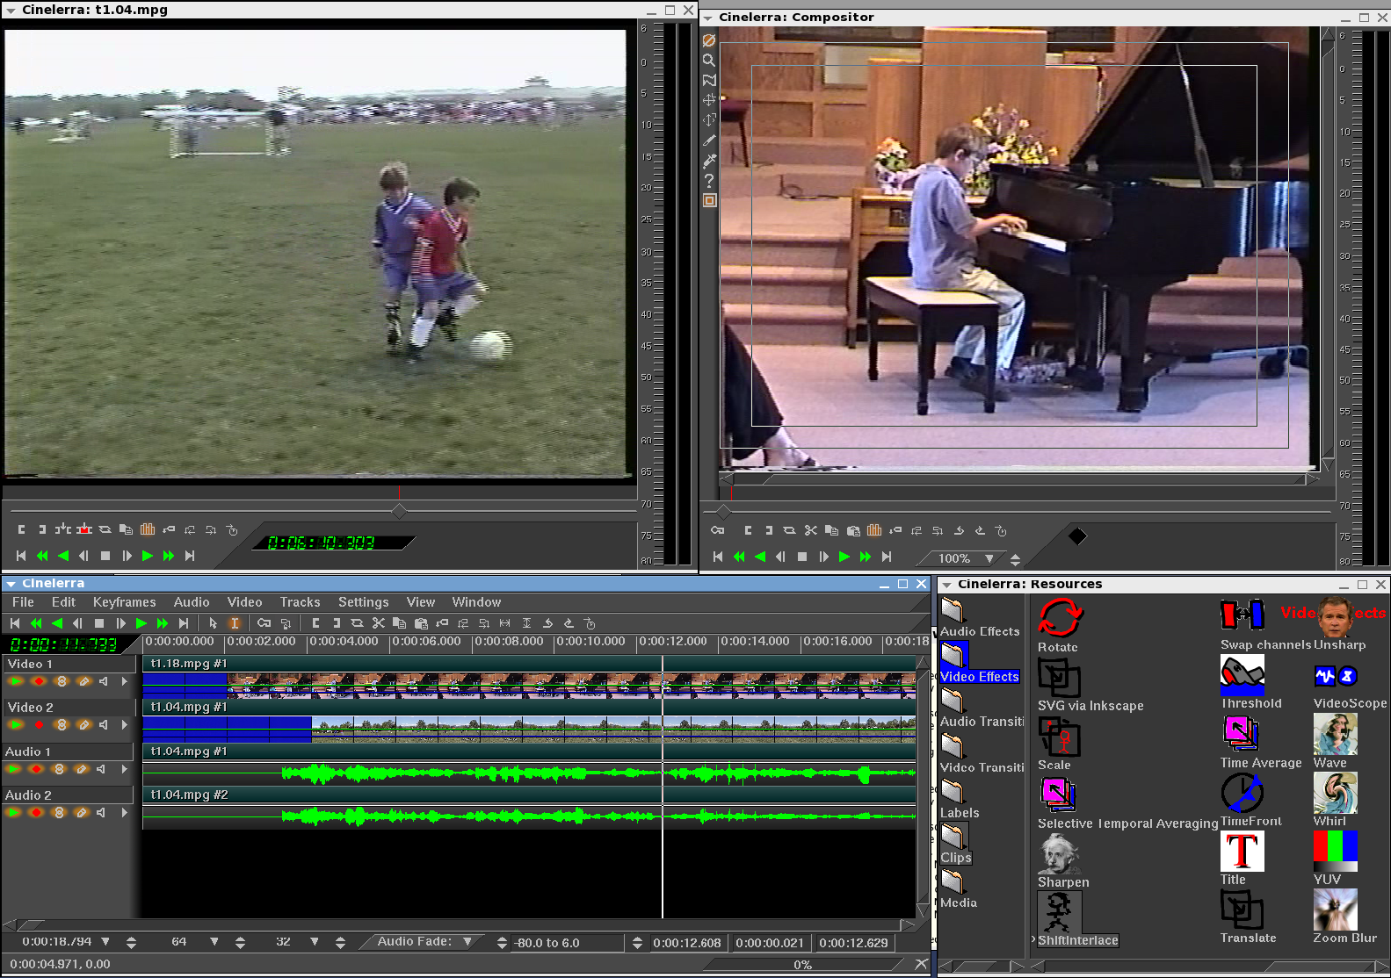
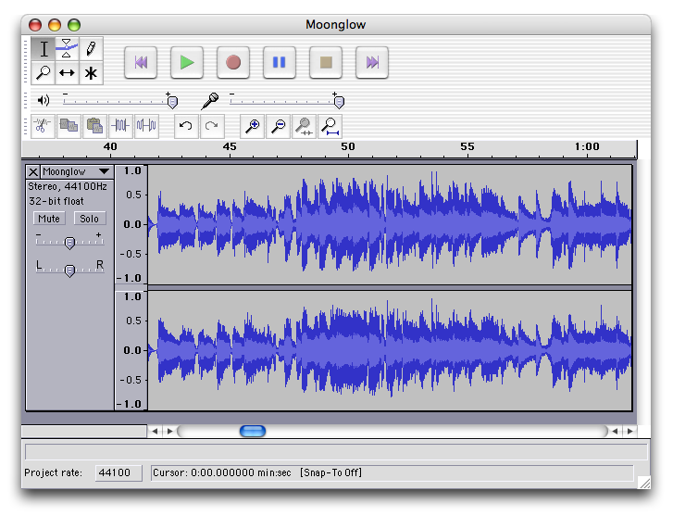
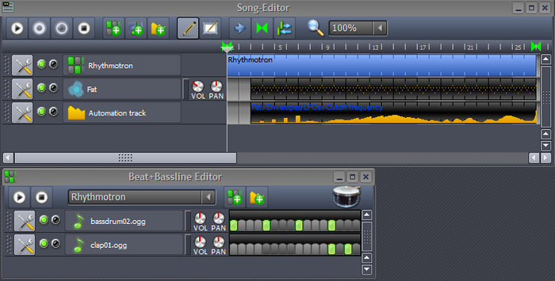
Contoh MultiMedia

Slide 13
PROGRAMING
  Web Programming
  Desktop Programming
  Analysis Programming

Slide 14

PROGRAMING
Web Programing
Adobe Dream Weaver
XAMPP
NETBEANS
BlueFish
Geany
Xampp for Linux
LAMP
NETBEANS for Linux

Slide 15
PROGRAMING
Desktop Programing
Borland Delphi
C/C++
Visual Basic
Lazarus
Gcc
GAMBAS

Slide 16
PROGRAMING
Analysis Programming
SPSS
Eviews
MATLAB
PSPP
SOFA
GRETL
OCTAVE
MATLAB

Slide 17

INTERNET
  Browser
  Messenger
  Social Network

Slide 18
INTERNET
Browser
Internet Explore
Opera
Mozilla Firefox
Google Chrome
MAXTHON
Mozilla Firefox
Opera
Google Chrome
Chromium
Netscape Navigator

Slide 19

INTERNET
Messenger
Yahoo Messenger
Gtalk
MIRC
Skype
PIDGIN
EMPATHY
Skype for Linux

Slide 20

INTERNET
Social Network
Tweet DECK
DIGSBY
HOTOT
GWIBBER
Ekiga

Slide 21
SYSTEM TOOLS
Partition Magic
VMWare
VirtualBox
Teamviewer
Gparted
VirtualBox
Qemu
VMWare
Teamviewer

Slide 22
Sumber
http://ugos.ugm.ac.id/wiki/panduan:panduan_aplikasi_pengganti_windows_di_linux
http://alternativeto.net/
http://repo.unnes.ac.id/v2/?p=625
http://linux.about.com/

Slide 23

Aplikasi Tambahan
Aplikasi baru karya anak Bangsa yang ada di IGOS Nusantara adalah :
IGN-SDK
IGN-Impress

Slide 24

INGA-INGA
Pilihan anda setelah ini adalah menjadi :
PENJAHAT
atau
PENJAHIT

Slide 25



Terima Kasih
IGN-DEV
SEKIAN

